Slide 1
Introduction to Computational Thermodynamics
Section 2
Equations of State

Slide 2
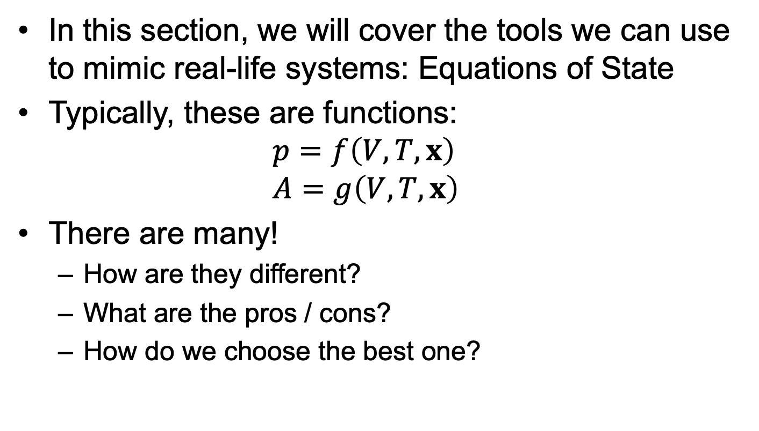
Introduction
In this section, we will cover the tools we can use to mimic real-life systems: Equations of State
Typically, these are functions: $p=f\left(V,T,x\right)$ $A=g\left(V,T,x\right)$
There are many!
How are they different?
What are the pros / cons?
How do we choose the best one?

Slide 3
Introduction
This section is split into 5 parts:
Ideal gas equations
Activity coefficient models
Cubic equations of state
SAFT equations
Multi-parameter equations

Slide 4
Introduction to Computational Thermodynamics
Section 2.1
Ideal Gas Equation

Slide 5
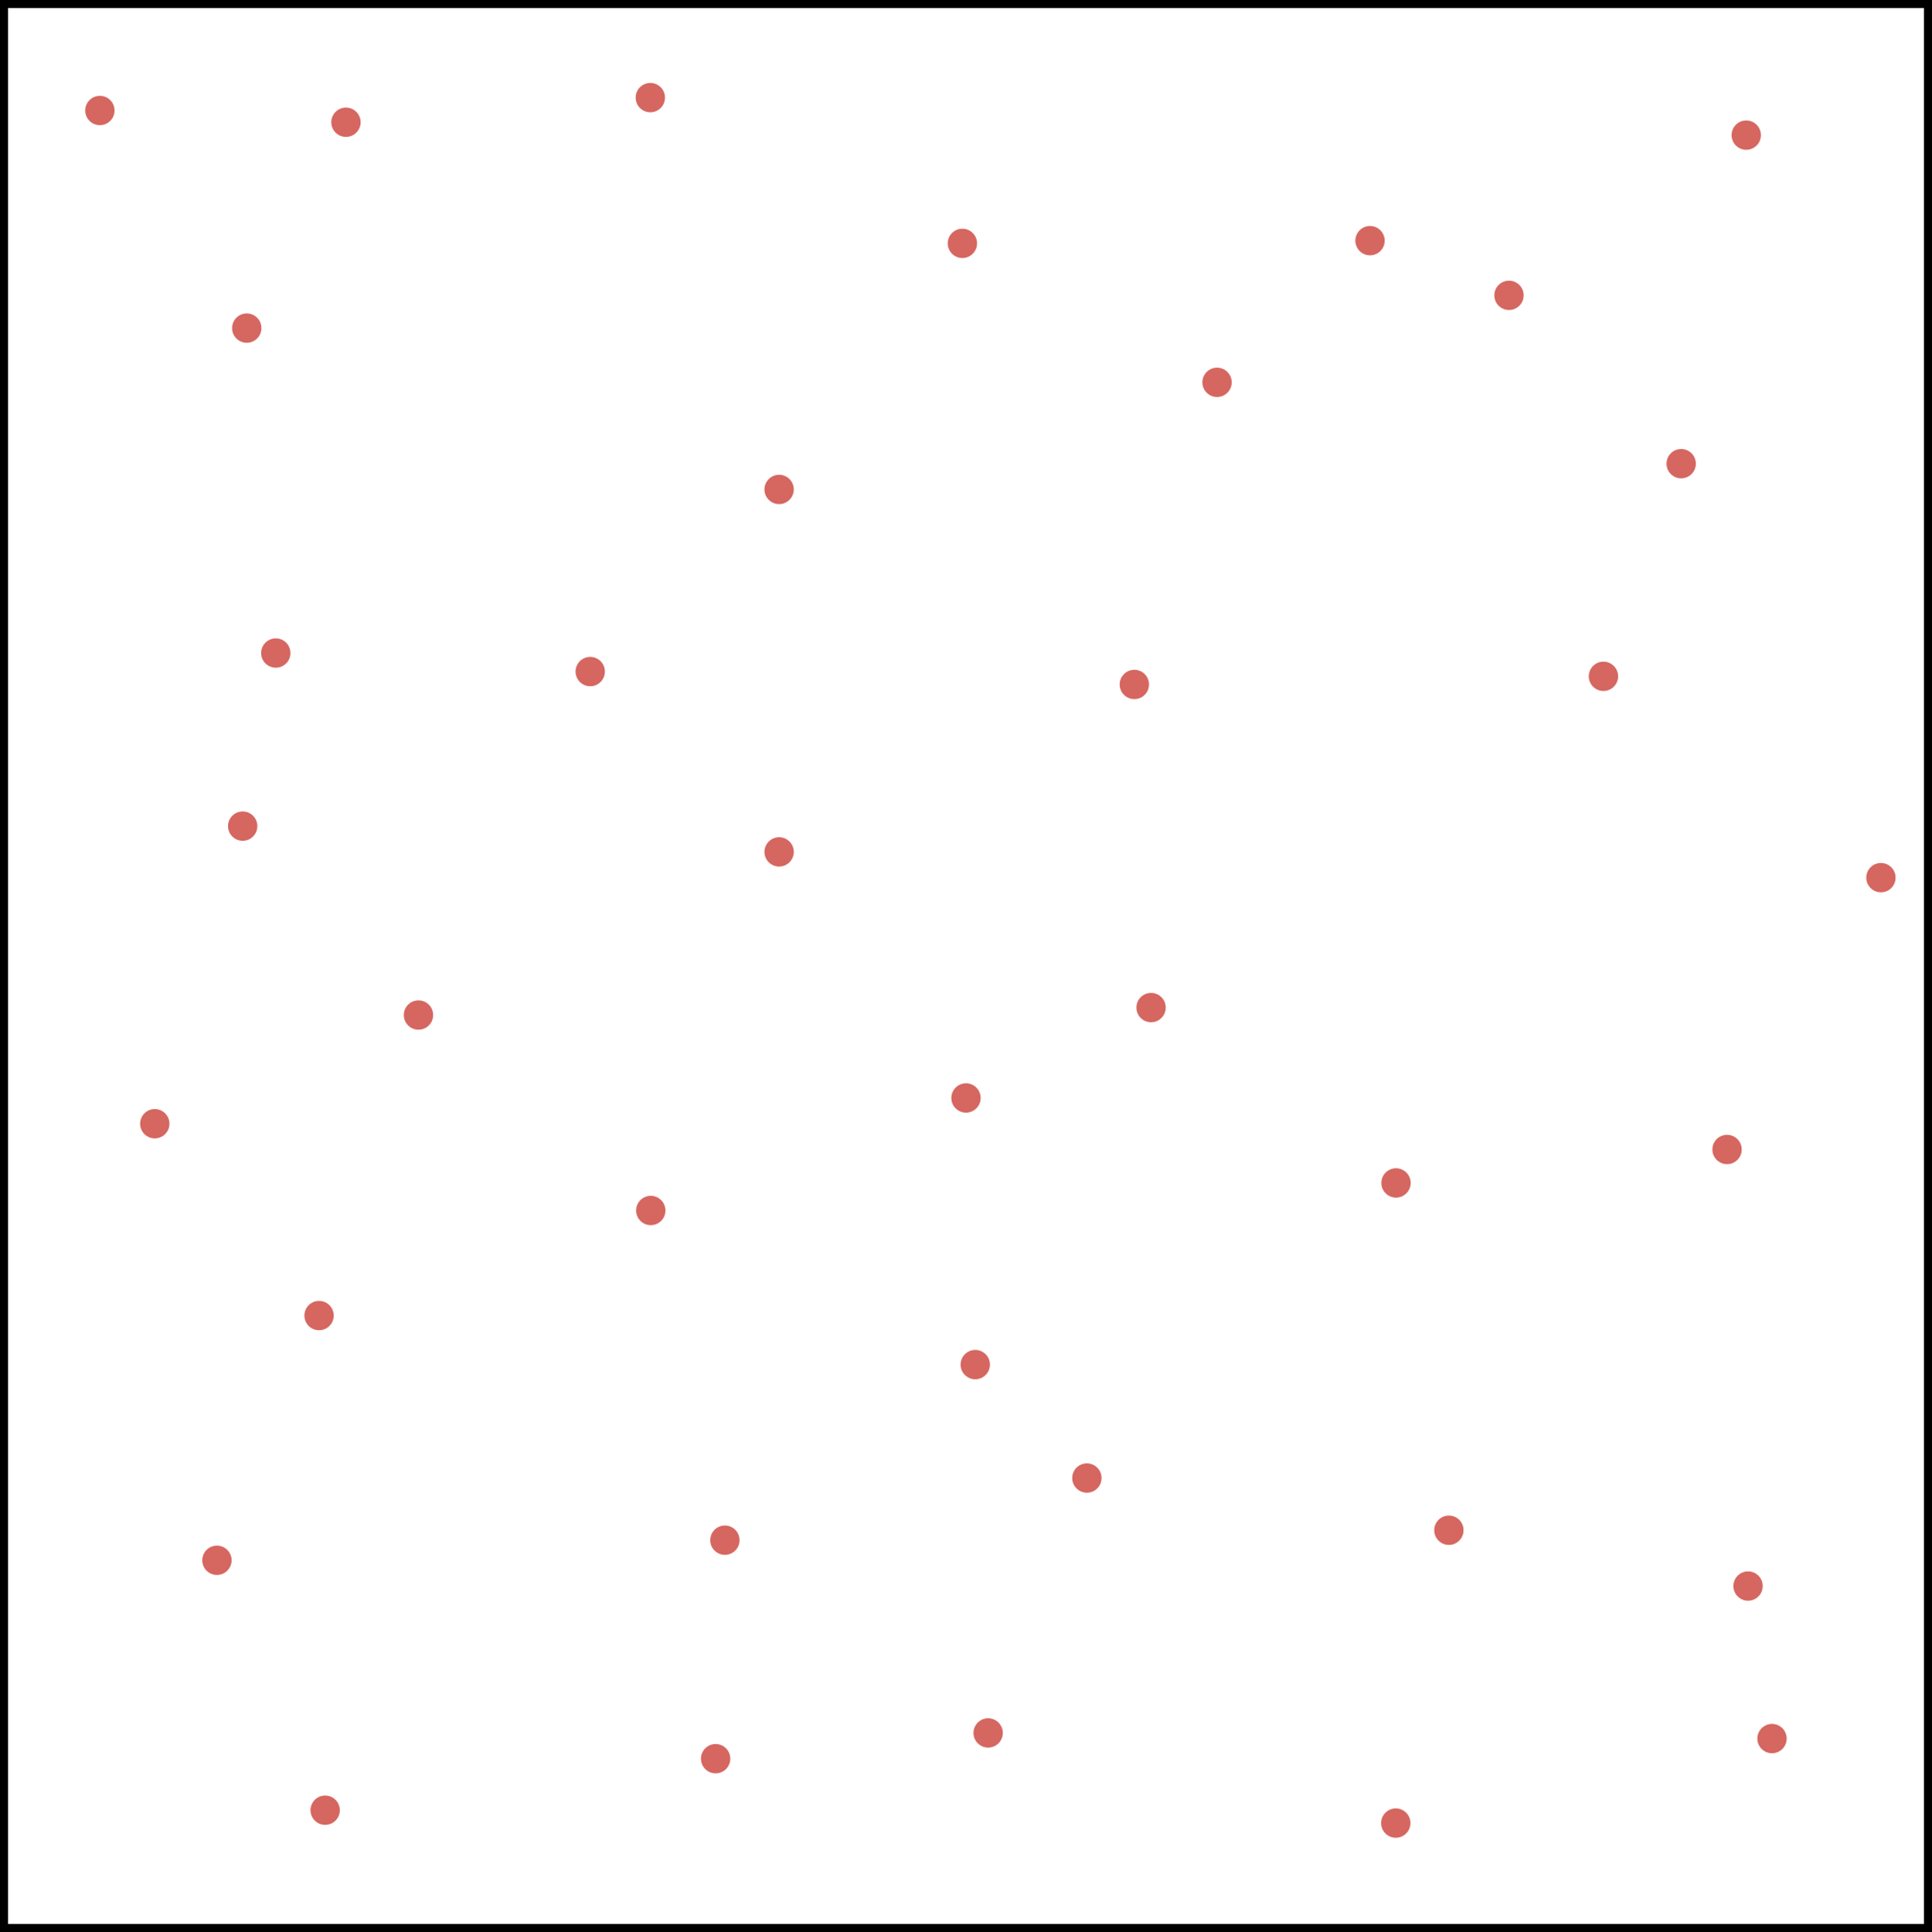
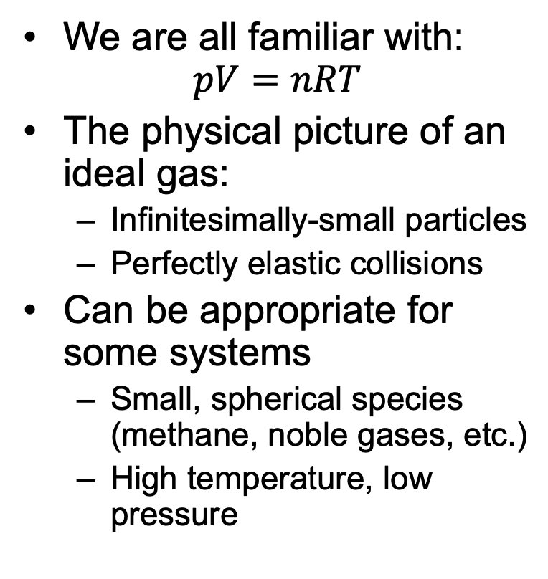
Ideal Gas Equation
We are all familiar with: $pV=nRT$
The physical picture of an ideal gas:
Infinitesimally-small particles
Perfectly elastic collisions
Can be appropriate for some systems
Small, spherical species (methane, noble gases, etc.)
High temperature, low pressure

Slide 6
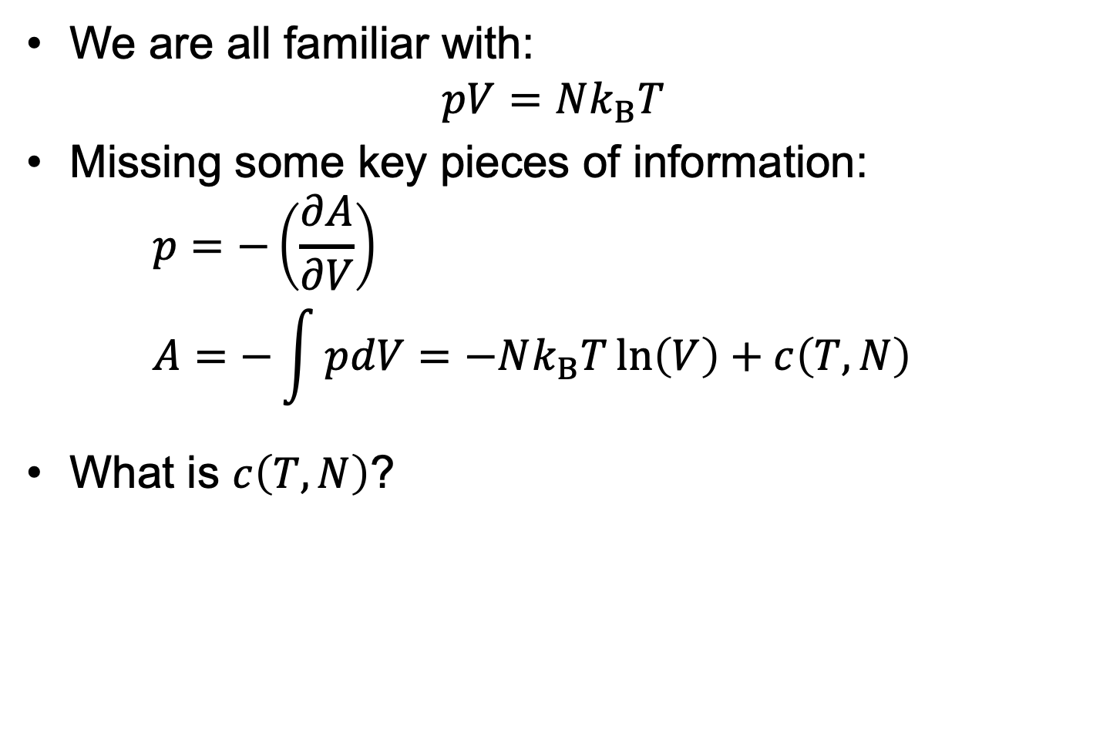
Ideal Gas Equation
We are all familiar with: $pV=Nk_{B}T$
Missing some key pieces of information: $p=−\left(\frac{∂A}{∂V}\right)$ $A=−\int{pdV}=−Nk_{B}T\ln\left(V\right)+c\left(T,N\right)$
What is $c\left(T,N\right)$?

Slide 7
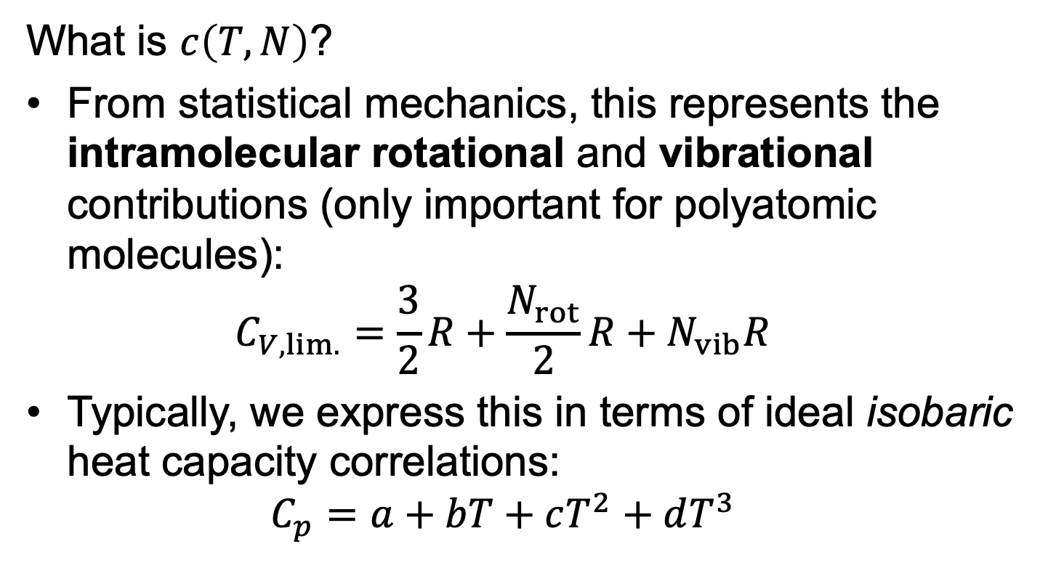
Ideal Gas Equation
What is $c\left(T,N\right)$?
From statistical mechanics, this represents the intramolecular rotational and vibrational contributions (only important for polyatomic molecules): $C_{V,lim.}=\frac{3}{2}R+\frac{N_{rot}}{2}R+N_{vib}R$
Typically, we express this in terms of ideal isobaric heat capacity correlations: $C_{p}=a+bT+cT^{2}+dT^{3}$

Slide 8
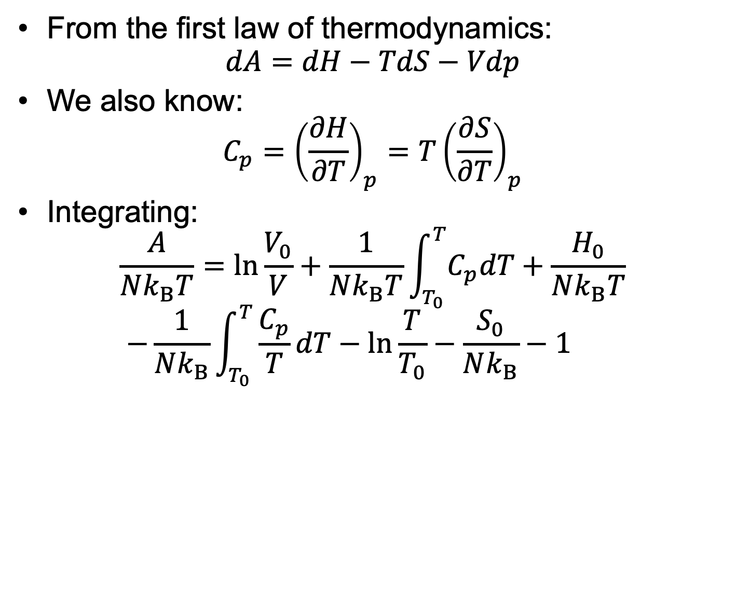
Ideal Gas Equation
From the first law of thermodynamics: $dA=dH−TdS−Vdp$
We also know: $C_{p}={\left(\frac{∂H}{∂T}\right)}_{p}=T{\left(\frac{∂S}{∂T}\right)}_{p}$
Integrating: $\frac{A}{Nk_{B}T}=\ln{\frac{V_{0}}{V}}+\frac{1}{Nk_{B}T}\int_{T_{0}}^{T}{C_{p}dT}+\frac{H_{0}}{Nk_{B}T}$ $−\frac{1}{Nk_{B}}\int_{T_{0}}^{T}{\frac{C_{p}}{T}dT}−\ln{\frac{T}{T_{0}}}−\frac{S_{0}}{Nk_{B}}−1$

Slide 9
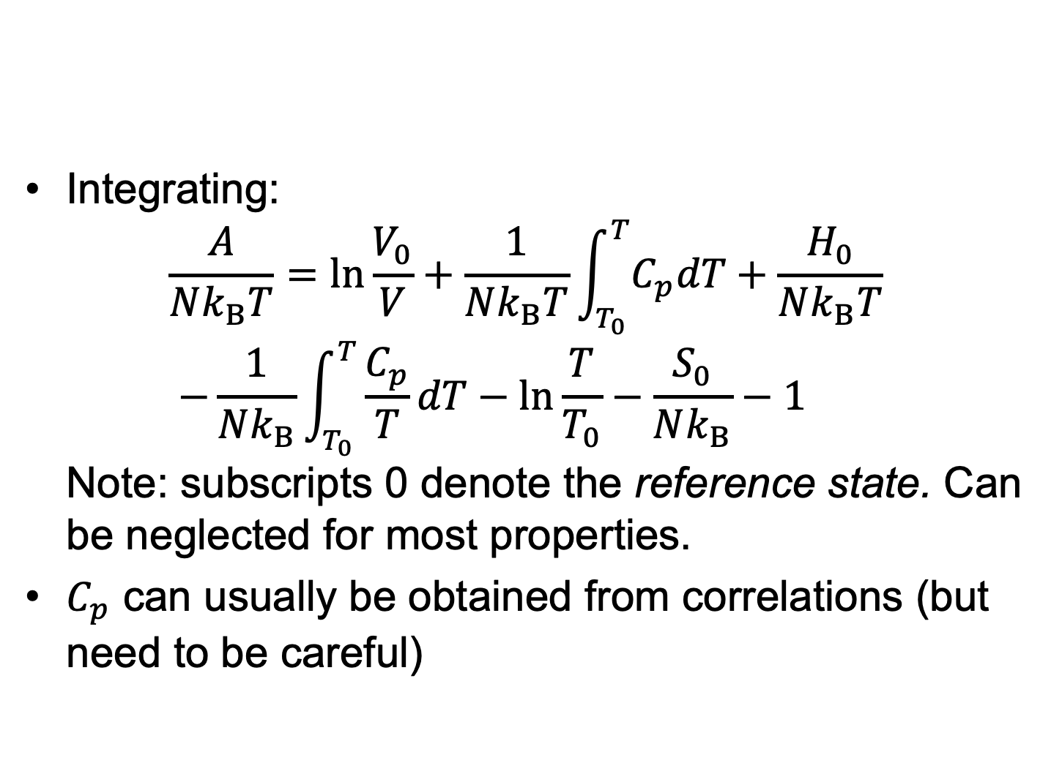
Ideal Gas Equation
Integrating: $\frac{A}{Nk_{B}T}=\ln{\frac{V_{0}}{V}}+\frac{1}{Nk_{B}T}\int_{T_{0}}^{T}{C_{p}dT}+\frac{H_{0}}{Nk_{B}T}$ $−\frac{1}{Nk_{B}}\int_{T_{0}}^{T}{\frac{C_{p}}{T}dT}−\ln{\frac{T}{T_{0}}}−\frac{S_{0}}{Nk_{B}}−1$ Note: subscripts 0 denote the reference state. Can be neglected for most properties.
$C_{p}$ can usually be obtained from correlations (but need to be careful)

Slide 10
Ideal Gas Equation
Integrating: $\frac{A}{Nk_{B}T}=\ln{\frac{V_{0}}{V}}+\frac{1}{Nk_{B}T}\int_{T_{0}}^{T}{C_{p}dT}+\frac{H_{0}}{Nk_{B}T}$ $−\frac{1}{Nk_{B}}\int_{T_{0}}^{T}{\frac{C_{p}}{T}dT}−\ln{\frac{T}{T_{0}}}−\frac{S_{0}}{Nk_{B}}−1$ Note: subscripts 0 denote the reference state. Can be neglected for most properties.
$C_{p}$ can usually be obtained from correlations (but need to be careful)

Slide 11

Ideal Gas Equation
$C_{p}$ can usually be obtained from correlations (but need to be careful)
ReidIdeal (correlation) can give unphysical values!

Slide 12
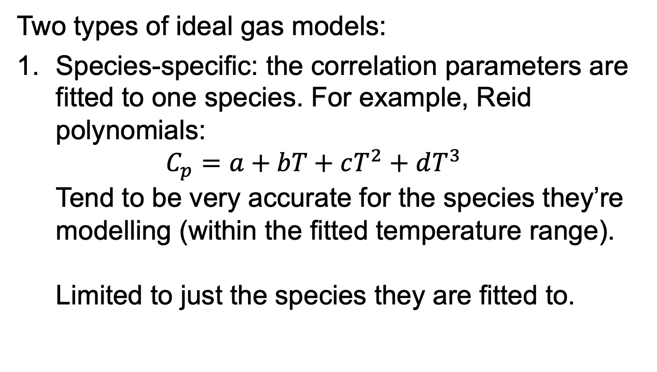
Ideal Gas Equation
Two types of ideal gas models:
Species-specific: the correlation parameters are fitted to one species. For example, Reid polynomials: $C_{p}=a+bT+cT^{2}+dT^{3}$ Tend to be very accurate for the species they’re modelling (within the fitted temperature range). Limited to just the species they are fitted to.

Slide 13
Ideal Gas Equation
Two types of ideal gas models:
Group-contribution: Species are assembled from ‘groups’: Parameters are now associated with the groups, not species.

Slide 14
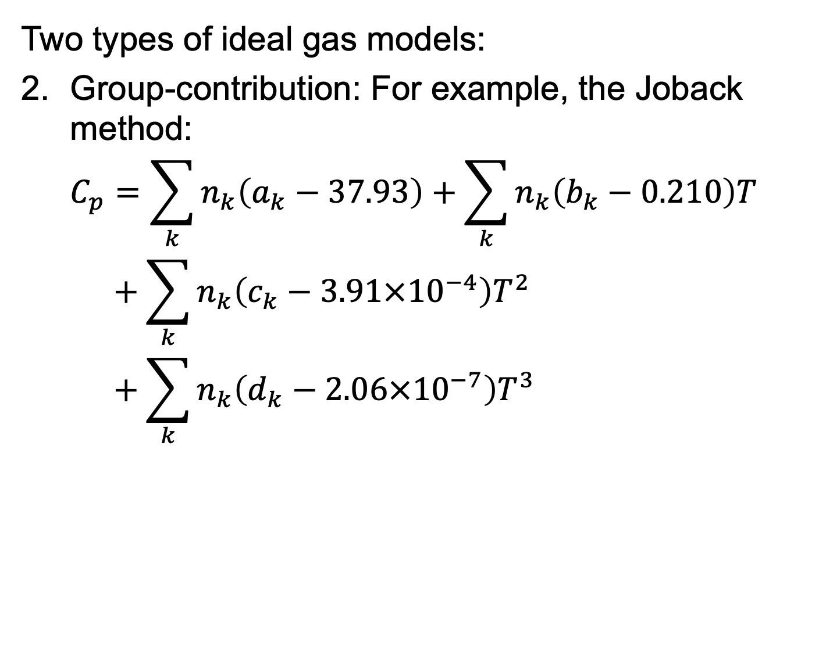
Ideal Gas Equation
Two types of ideal gas models:
Group-contribution: For example, the Joback method: $C_{p}=\sum_{k}{n_{k}\left(a_{k}−37.93\right)}+\sum_{k}{n_{k}\left(b_{k}−0.210\right)T}$ $C_{p}+\sum_{k}{n_{k}\left(c_{k}−3.91×{10}^{−4}\right)T^{2}}$ $C_{p}+\sum_{k}{n_{k}\left(d_{k}−2.06×{10}^{−7}\right)T^{3}}$

Slide 15
Ideal Gas Equation
Two types of ideal gas models:
Group-contribution: A few comments:
With a small set of parameters, can model a large range of species
Less accurate than species-specific approaches
Typically, if more-specific groups can be used to model a species, it should be more accurate:
vs

Slide 16
Ideal Gas Equation
There are many ideal gas models to choose from:
Make sure to test how accurate the predictions are!
Species-specific:
Reid polynomial
NASA polynomial
Wilhoit correlation
Aly and Lee
Group-contribution:
Joback method
Coniglio et al.
Walker and Haslam

Slide 17
Ideal Gas Equation
The ideal contribution can be very important, even for real properties of complex species.
Switch to notebook and show “live” implementation

Slide 18
Key Points
Ideal models need to account for translational, rotational and vibrational contributions.
Ideal isobaric heat capacity models can be used to provide the missing contributions.
Need to evaluate whether the correlations are appropriate within the conditions.
Can verify that the equipartition theory limit is satisfied
Group-contribution approaches provide methods to obtain predictions for species with little experimental data.

